Slide 1

Neural Network Implementation on FPGA
Lang Feng, Hongxin Kong

Slide 2
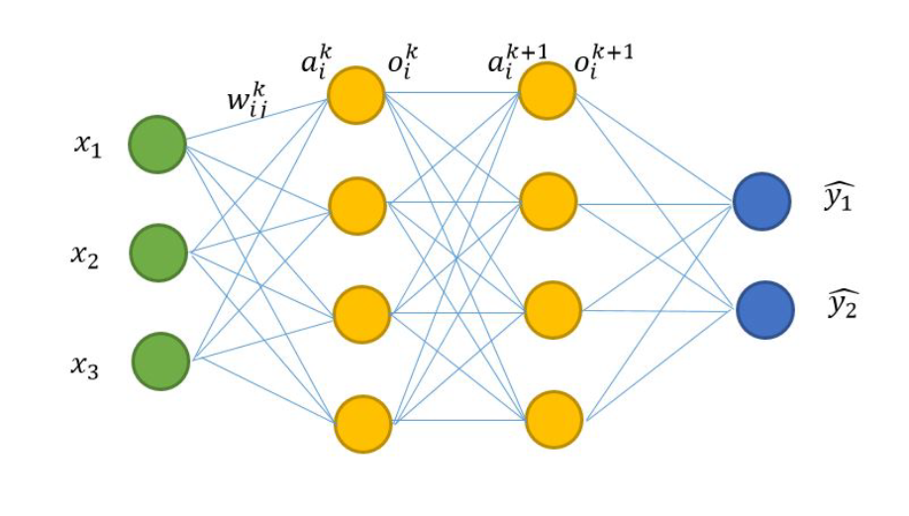
Problem statement
FPGA
A good accuracy with reasonable cost
Configurable(function as different NN when we change the parameters)
Realize training process on FPGA

Slide 3
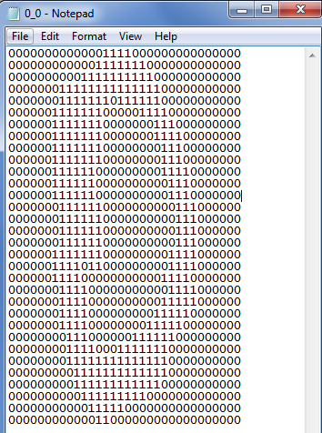
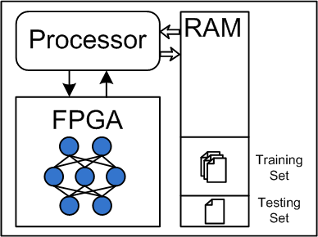
Implementation Details
Allocate memory for FPGA to read, Read data from SD card to RAM and from RAM to allocated memory
Store data from SD card
32*32 digits
1800 data in training set
946 data in testing set

Slide 4
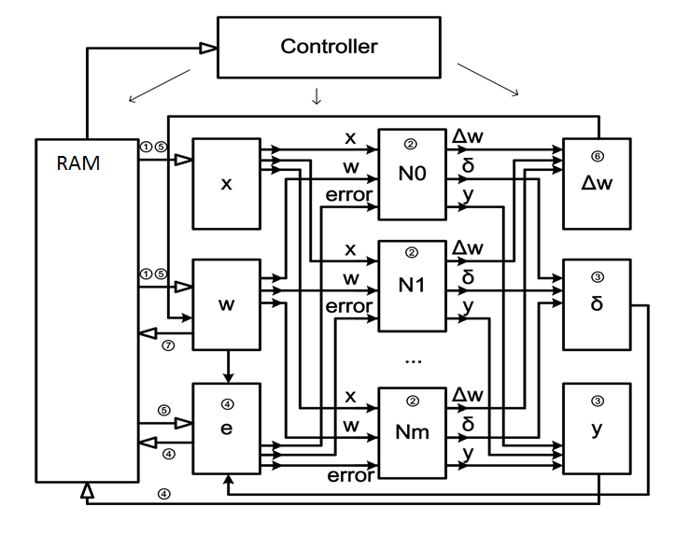
Implementation Details
FPGA PART
Intel DE1-SoC
Configurable for different NN
1 byte to Show the number of inputs
128MB for data
1 byte to Show the number of neurons
256Mb for weights

Slide 5
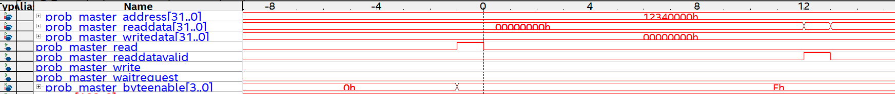
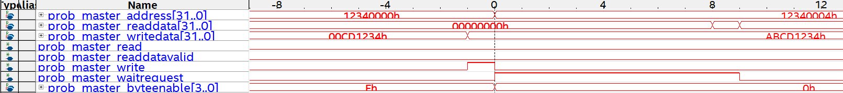
Results
----------------Realize Communication between processor Memory and FPGA
AXI BUS
The Waveform of reading 4 bytes
The Waveform of writing 4 bytes

Slide 6
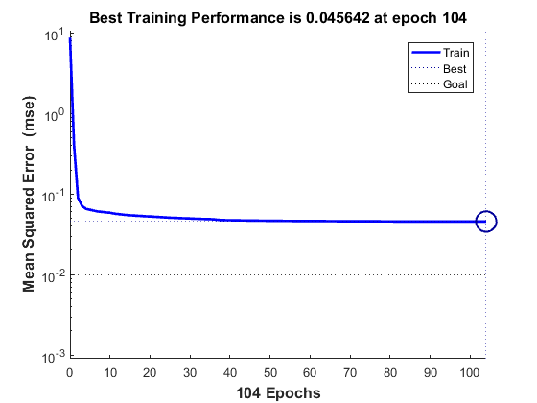
Results
----------------MATLAB simulation result
Setup : 30 Neurons in Hidden layer, 32 inputs and 10 outputs
Training accuracy | 75.54%
Testing accuracy | 64%

Slide 7
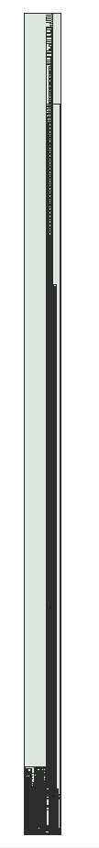
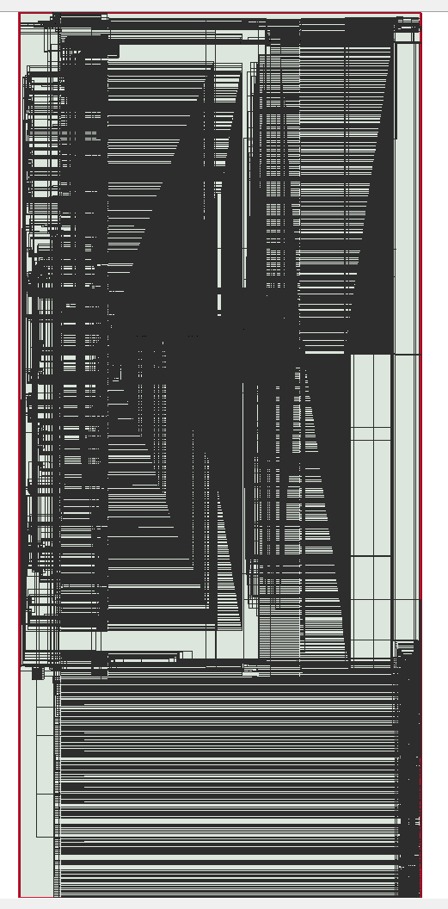
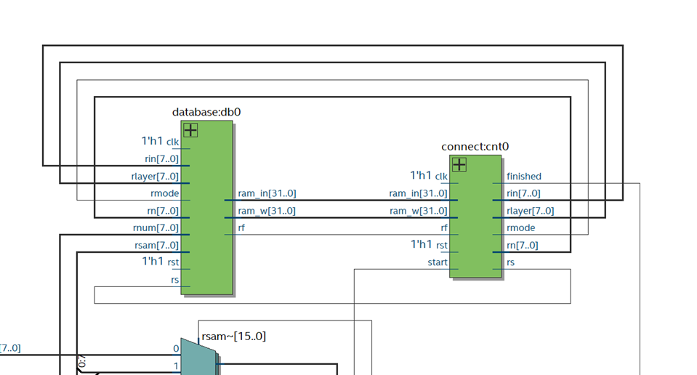
Results
----------------FPGA Netlist
Controller + NN
Directly Mapped
Recurrent

Slide 8
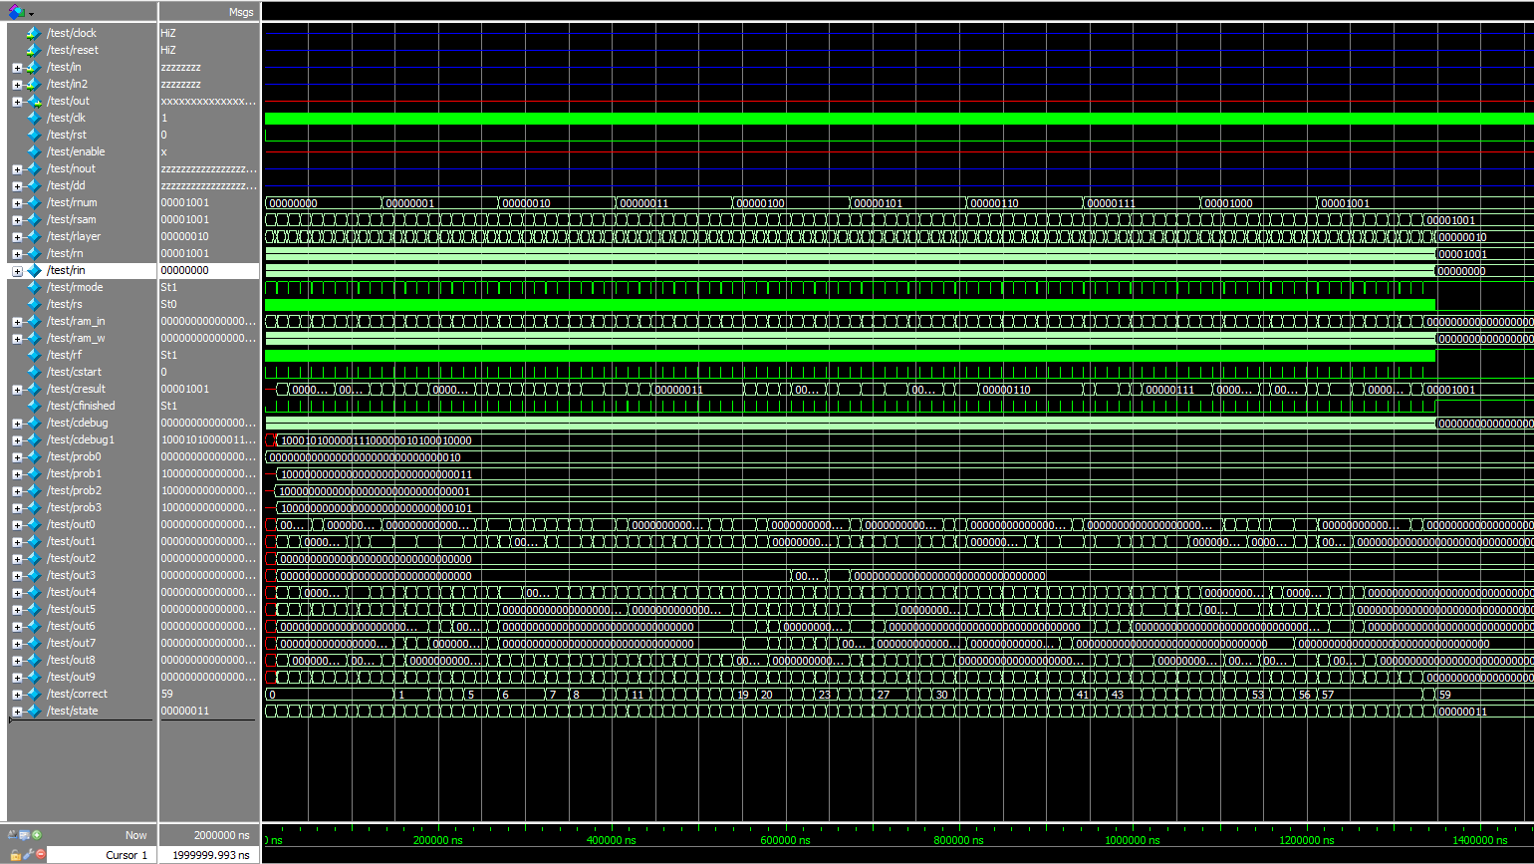
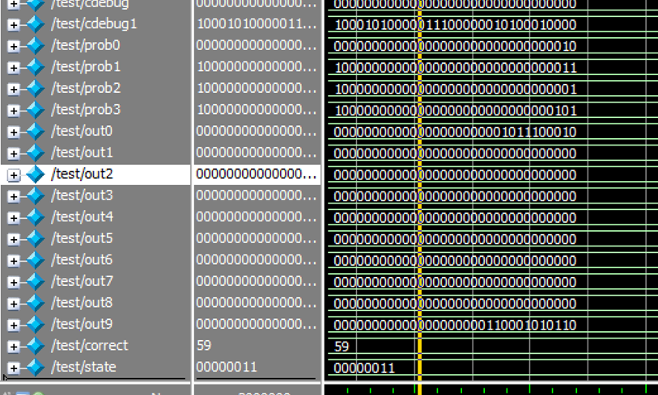
Results
----------------FPGA Implementation result
FPGA with a testing accuracy: 59%
Compared to 64% in PC, not a big drop.
Calculate 100 samples takes 1350000ns, 13500ns for each sample and 6750 clock cycles for each sample

Slide 9
Conclusion and Future work
What we have done
Realize NN on FPGA with relative high accuracy.
Realize configurable NN using same chip
Future work
Realize training function
Further reduce the sources

Slide 10
Thank You!

